Slide 1
Parents’ Meeting Rabbit Class
Thursday 8th September 2022

Slide 2
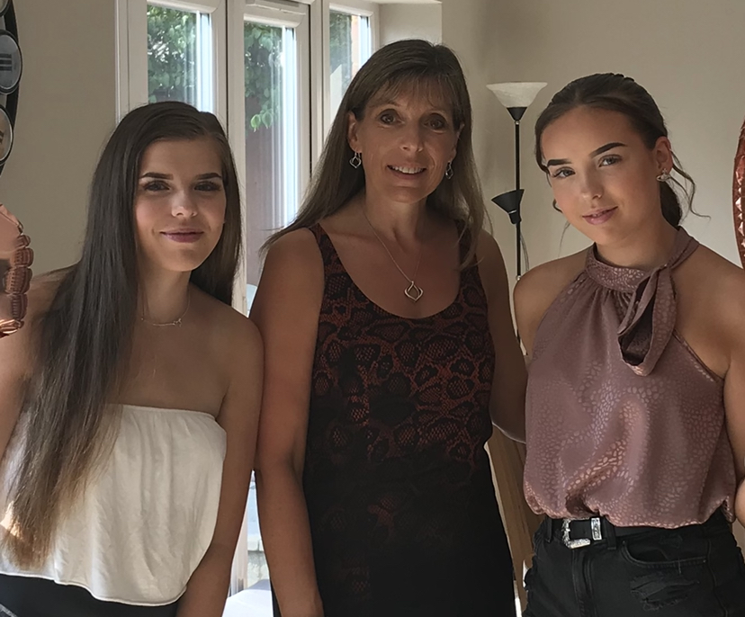
Mrs Smith
.
Bit about me!
I have worked at the school for 23 years first as a nursery nurse then
after studying and gaining a degree did my teacher training and have been
working as a teacher for the past 10 years
I have two adult daughters, who I brought up on my own, so I have a good
Understanding of the pressures of balancing a job and family life.
Please come to me if problems or worries, I hope I am approachable!

Slide 3
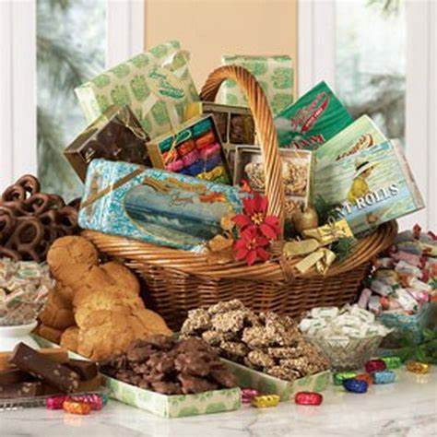
Curriculum this year
Basketful of memories
Summer Term Topic
Ice world
These are based around central topics, the first is are more history focussed and others are geography and science based. All aspects of the curriculum are covered within them.

Slide 4
Reading
School reading scheme books will come home to share and read at home.
Just read a few pages- don’t feel you have to do the whole book.
Discuss what they have read to show understanding.
When you have finished write what page you have got to or if the book is finished.
We aim to listen to the children read at least twice a week.

Slide 5
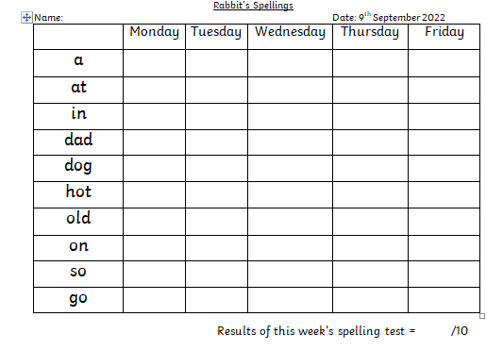
Weekly Spelling
One sheet will come home each week with the spelling they are to
practise a duplicate will stay in school and for the children to use during morning registration.
The first four words are from their word box and from the hundred high frequency word they are expected to read and spell by year 2. The other words are linked to the phonics sound we are learning that week.
Each day look, cover and write. They can do this on their own.
Every Friday morning we will have a spelling test.
I will put the results onto the new spelling sheet which will come home that evening.

Slide 6
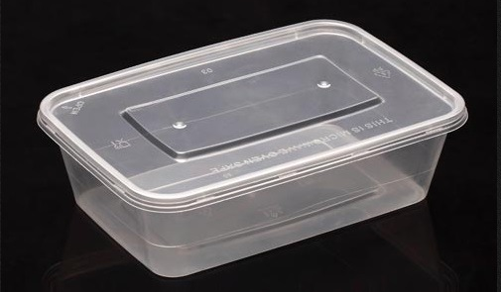
Word Boxes
The four high frequency words on the weekly spelling sheet will be added to the children's word boxes. These are to help with practising over the year. I will test as the year goes by and when they can read and spell a word I will take it out of the boxes.
These boxes do break from time to time. Please feel free to replace them with a more sturdy box of a similar if not smaller size!

Slide 7
Homework books
Each week I will set a piece of homework. This will be connected or to something else we have been learning that week (English, Maths, Science or Topic focused)
so it should not be alien to your child.
They are mostly short pieces of work and should take no longer that 15 -20 minutes.
Please, if you child gets distress with a piece of homework then leave it and chat with me.
This week’s homework: make a collection of memories from your life so far, from holidays, birthdays, special events etc ( photos to order by age, (baby, 1 2 3 4 5)

Slide 8
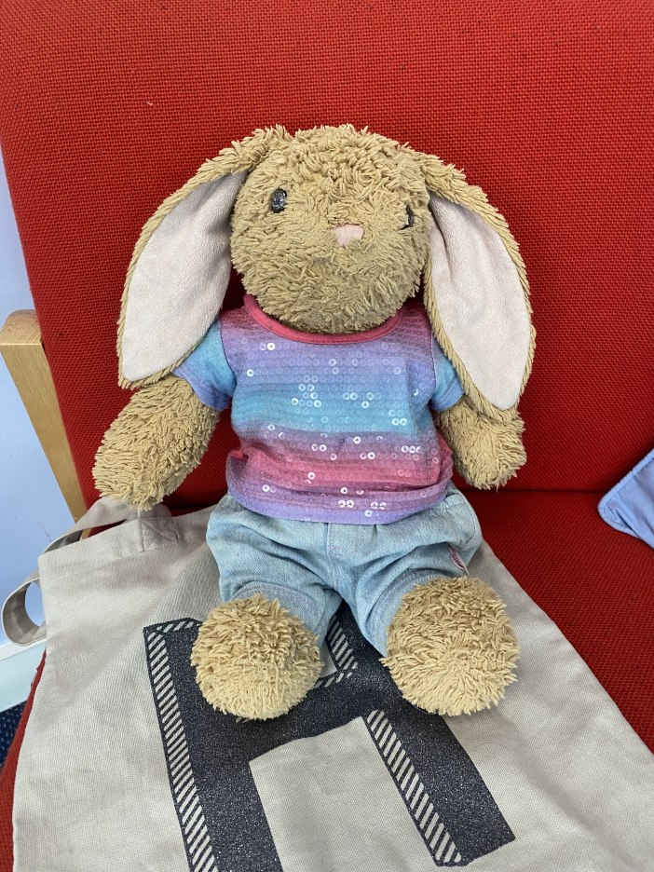
Hopping Holly
Hopping Holly is our class rabbit.
She likes to go home with children
at the weekend as she gets very lonely
in school on her own!!
This is an opportunity for your child to
write for a purpose, telling us all about what Holly got up to the weekend she stayed with you.
It only need to be a couple of sentences.
A drawing or photo to would be great to accompany the writing.

Slide 9
Library Books
Every Thursday we will use our school library and the children will
have time to choose a book of their choice.
They can take it home and bring it back the next Thursday.
I keep a record of the book they have at home so if it gets muddled
with other books at home and you forget the title then I can help.

Slide 10
Dojo
The Class Dojo App is a way of communicating for the children, parents and
teachers. It is used throughout Sheerhatch from Year One and it will be used in many different ways as your child moves through the school.
We collect dojo points as a reward and it is also an excellent way for me to communicate with parents as a whole class or individually. You can also message me on it. Look out for an email.

Slide 11
Reminders
Coats in school every day and we sometime go on walks
and even if it is raining slightly the children will have a short
playtime.
Please make sure all your child's clothing is named,
including gloves, hats and scarves.
Tuesdays and Fridays are PE days so the children come to
School wearing PE kit, not school uniform.
If they are in a sports club but don’t have PE that day
then they will need to bring their kit to change into at the
end of the school day please.

Slide 12
Lastly…
I’m here at the end of each day so if you have any worries or concerns, please come and talk to me, no worry is too small.
Or feel free to Dojo me a message.

Slide 13
Thank you

