Slide 1
Music

Slide 2
https://sites.google.com/view/mfbb/home

Slide 3
https://sites.google.com/view/mfbb/home
If you enjoy making music, singing along to your favourite radio station or Disney songs, Bedford Borough have recently launched a website which will help you to continue with your music making.
Use the weblink above to access the home page for this exciting new site. Some pages are still under construction.
There are videos (starring a very well known face from our singing sessions at Sheerhatch!) and suggestions of activities and music making apps.
I’ve dedicated a page on each slide for the pages on the website so that you can have a look and see what takes your fancy!
Enjoy making music together. Who will be the next famous singer/songwriter or composer?

Slide 4
https://sites.google.com/view/mfbb/home
Early Years page
https://sites.google.com/view/mfbb/early-years
Sing a Rainbow
I Spy Colours singing game
https://www.bbc.co.uk/teach/school-radio/nursery-rhymes-songs-index/zhwdgwx
Link to BBC school radio site

Slide 5
https://sites.google.com/view/mfbb/home
Sing On
https://sites.google.com/view/mfbb/sing-on
Starring Mrs England!
Video 1: This video explains some of the basics of singing technique, posture and breathing, and then teaches you a little warm up exercise.
Video 2: This video expands the vocal warm up to a full body warm up in four parts, set to the timeless and catchy tunes of Glenn Miller.
Video 3:This video works more on your technique, giving you some scales to practice, a tongue twister and some more warm ups which will strengthen your voice.
Video 4: This video will get you singing along to the fun song Boom Chikka Boom. Listen closely to the small changes in this call and response singing game.
Video 5: In this video you will your first song, the Ghanaian folk tune Tue Tue. It's a beautiful song in two parts. Enjoy.

Slide 6
https://sites.google.com/view/mfbb/home
https://sites.google.com/view/mfbb/using-technology-to-create-and-play
Coming soon!
Keep checking in!

Slide 7
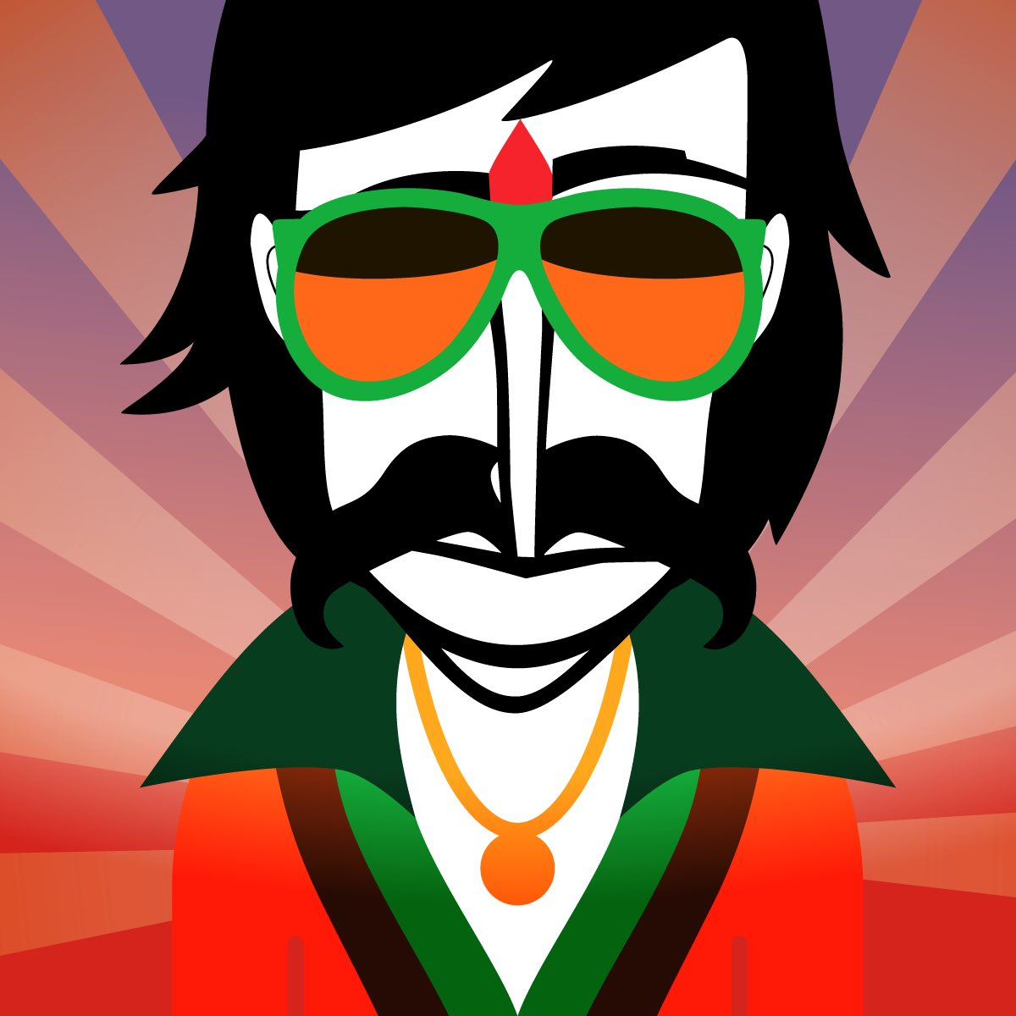
https://sites.google.com/view/mfbb/home
https://sites.google.com/view/mfbb/learn-to-play-drums-without-drums-quietly
Music technology!
Composing and songwriting apps.
GarageBand
LaunchPad
Music Maker Jam
Chrome Music Lab
Incredibox

Slide 8
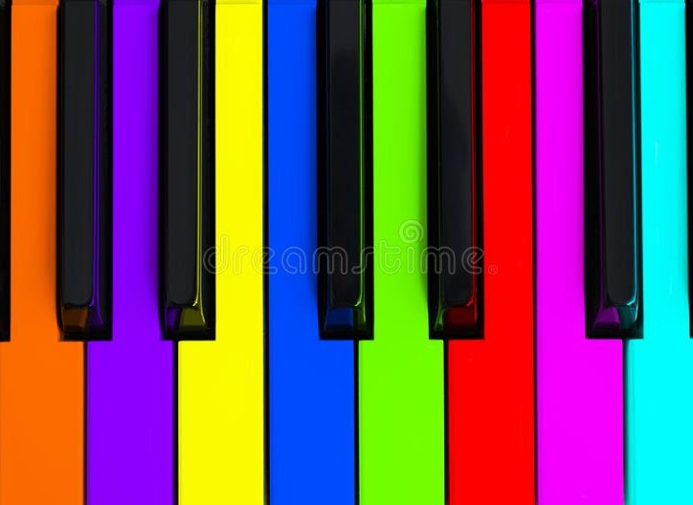
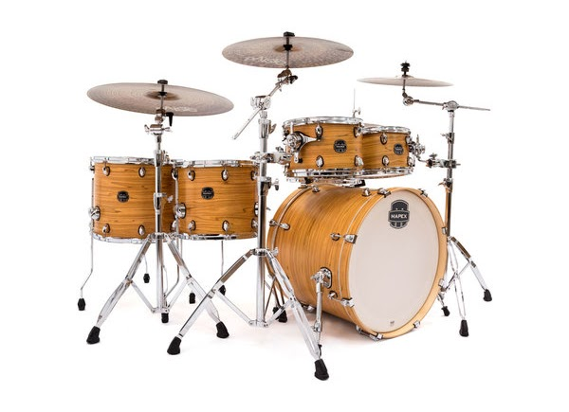
https://sites.google.com/view/mfbb/home
https://sites.google.com/view/mfbb/learn-to-play-drums-without-drums-quietly
Music technology!
Virtual instruments.
Online piano:-
https://www.onlinepianist.com/virtual-piano
Online drums:-
https://www.virtualdrumming.com/drums/online-virtual-games/online-virtual-games-drums.html
Simple music sampler:-
Keezy classic (apple app)
https://apps.apple.com/gb/app/keezy-classic/id605855595

Slide 9
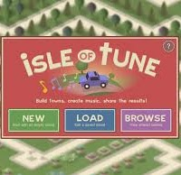
https://sites.google.com/view/mfbb/home
https://sites.google.com/view/mfbb/learn-to-play-drums-without-drums-quietly
Music technology!
Music making games.
Isle of Tune:-
Free in browser
https://musiclab.chromeexperiments.com/
Monkey Drum:-
Free apple app
https://apps.apple.com/us/app/monkey-drum/id483225765

Slide 10
https://sites.google.com/view/mfbb/home
https://sites.google.com/view/mfbb/music-theory
Coming soon!
Keep checking in!

Slide 11
https://sites.google.com/view/mfbb/home
https://sites.google.com/view/mfbb/pitch-and-rhythm
Pitch and rhythm
Dippy Doo
All Around the Kitchen
Music and Movement
Hakka
Baunwa
Find 4 Beats

